Slide 1
Dxc real time project
presented by
Smdraihan
DXC262AB12036

Slide 2
contents
Project 1: connected vehicles
Project 2: AP morgan data platform

Slide 3
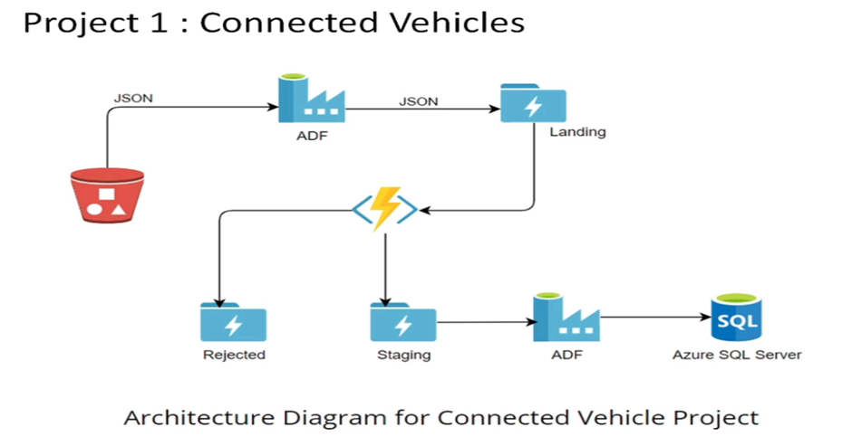
project 1:connected vehicles
Problem statement:moving data from staging to sql database using datafactory pipelines and triggers

Slide 4
things to do to create pipelines
●Creating azure data factory
●Creating Azure data factory pipeline
●Creating blob trigger logic
●Creating azure sql server and database
●Adding another pipeline to move data from staging to sql database

Slide 5
Services to build
To complete this project we need the resources
➢Azure Data Factory
➢Azure Storage Account
➢Azure SQL Database

Slide 6
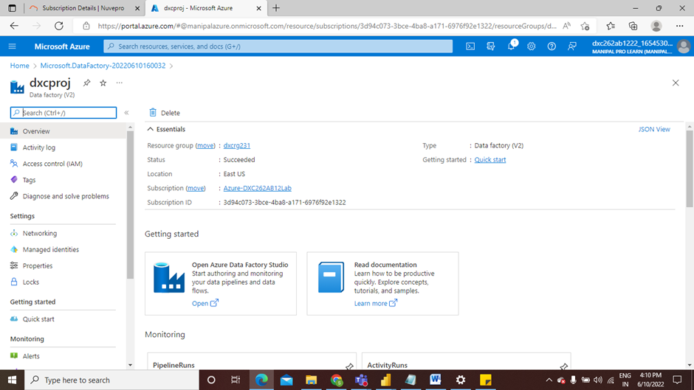
AZURE DATA FACTORY
●Create Azure Data Factory and go to open azure data factory studio

Slide 7
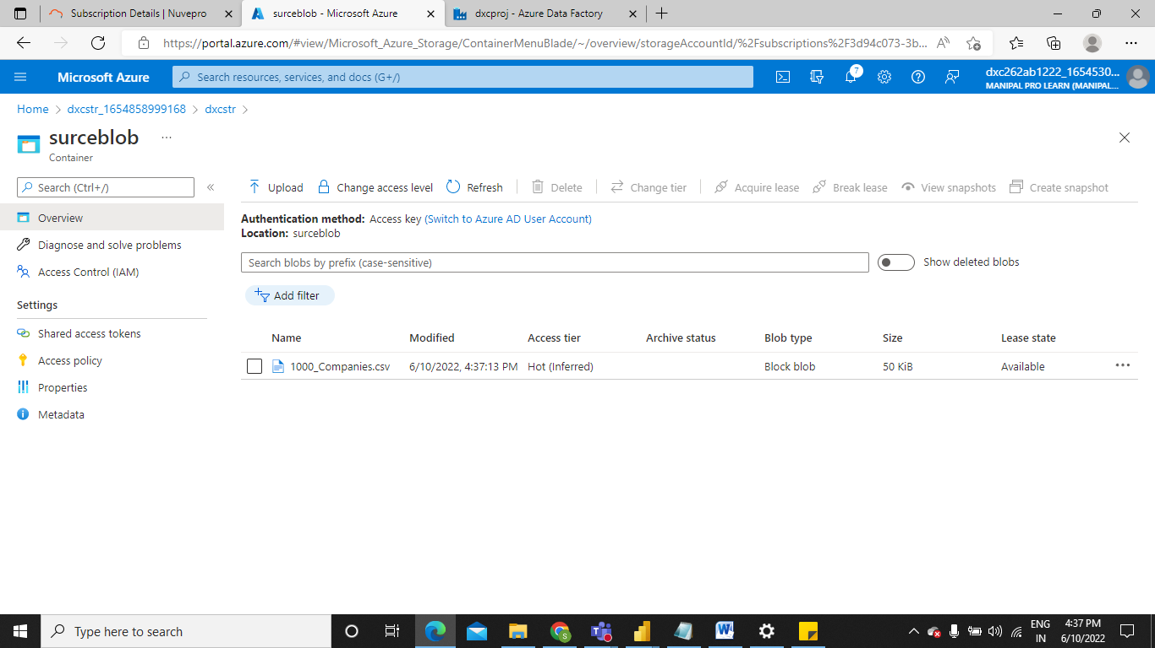
Then create storage account and create container
Create a storage account service and create a container as source blob where our destination will be sql database

Slide 8
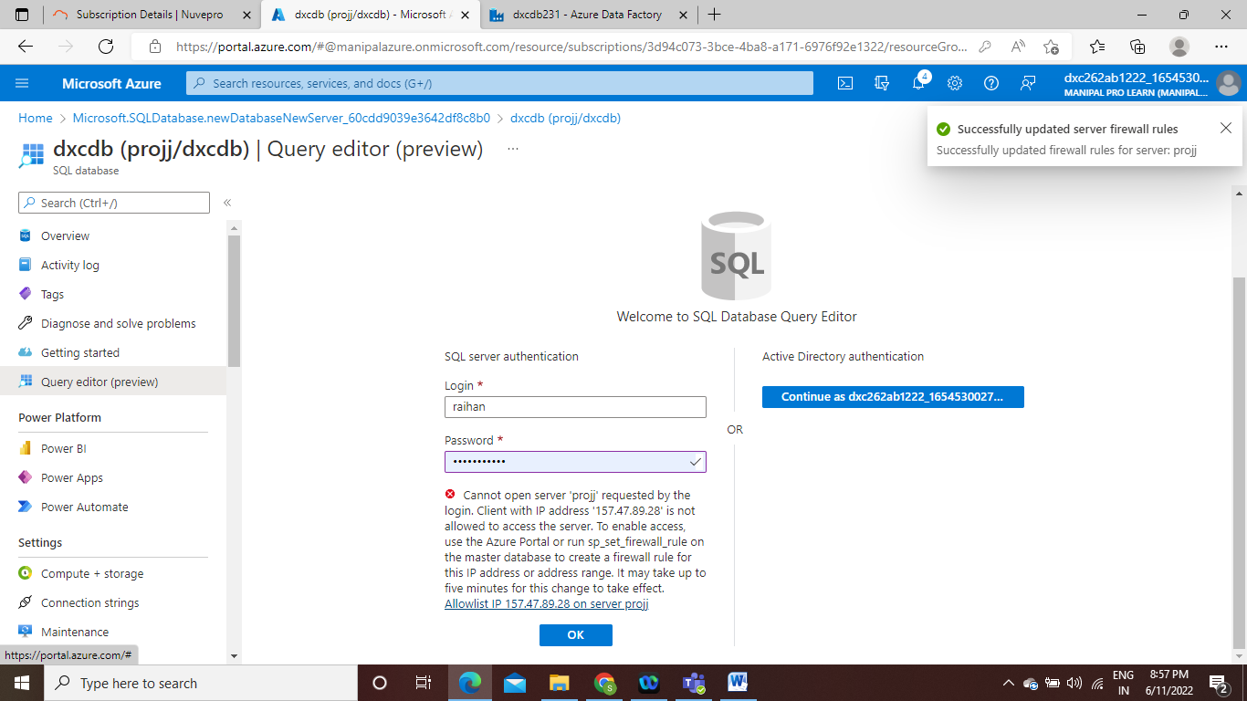
Create sql database which will be destination

Slide 9
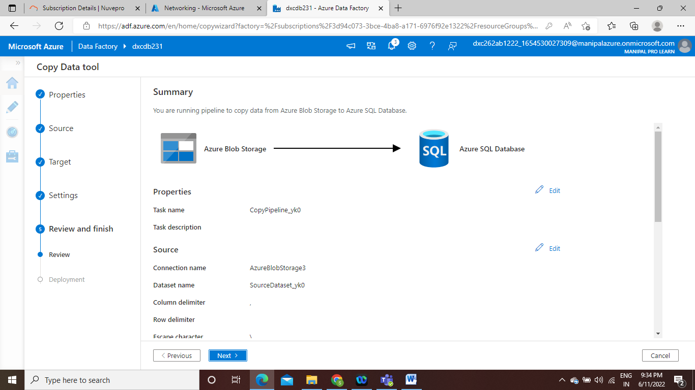
Connection of storage account and sql db using datafactory pipeline
After successfully creating pipeline it will showes as below

Slide 10
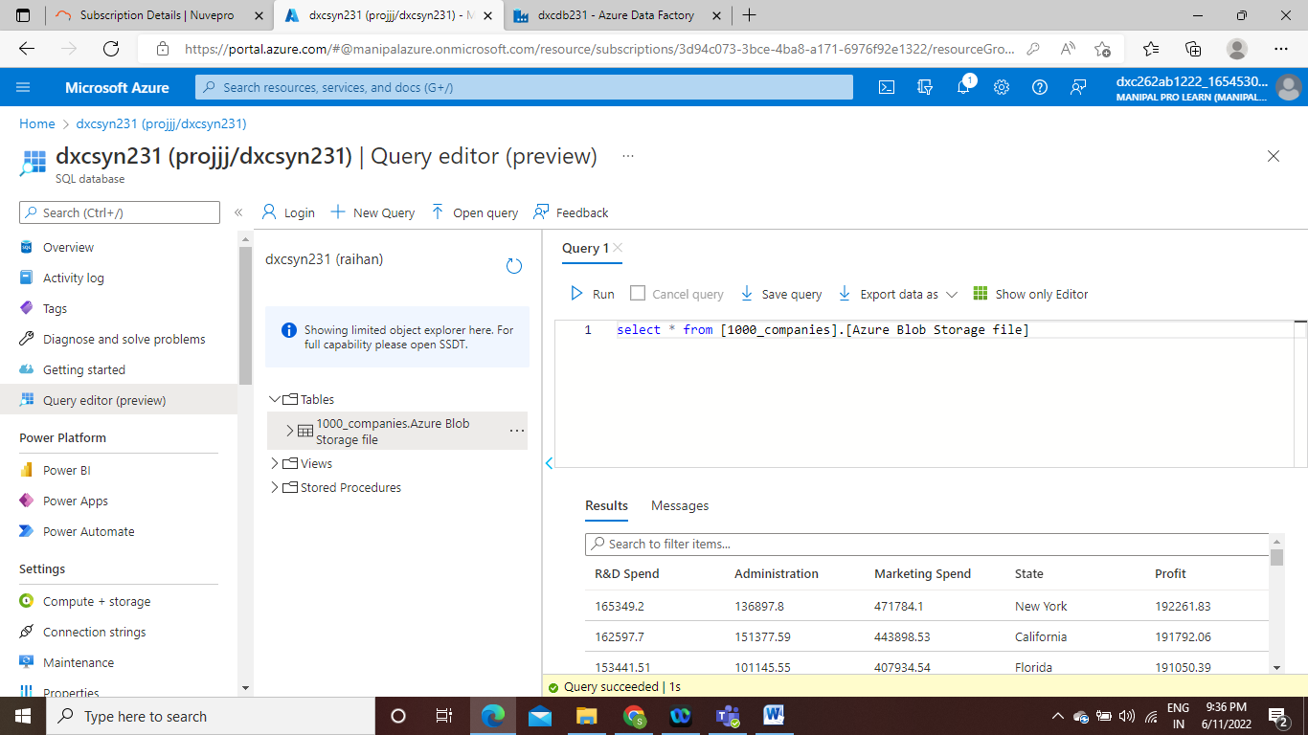
After connection
After connection the file which we have uploaded in storage account will be transfors to sql data base

Slide 11
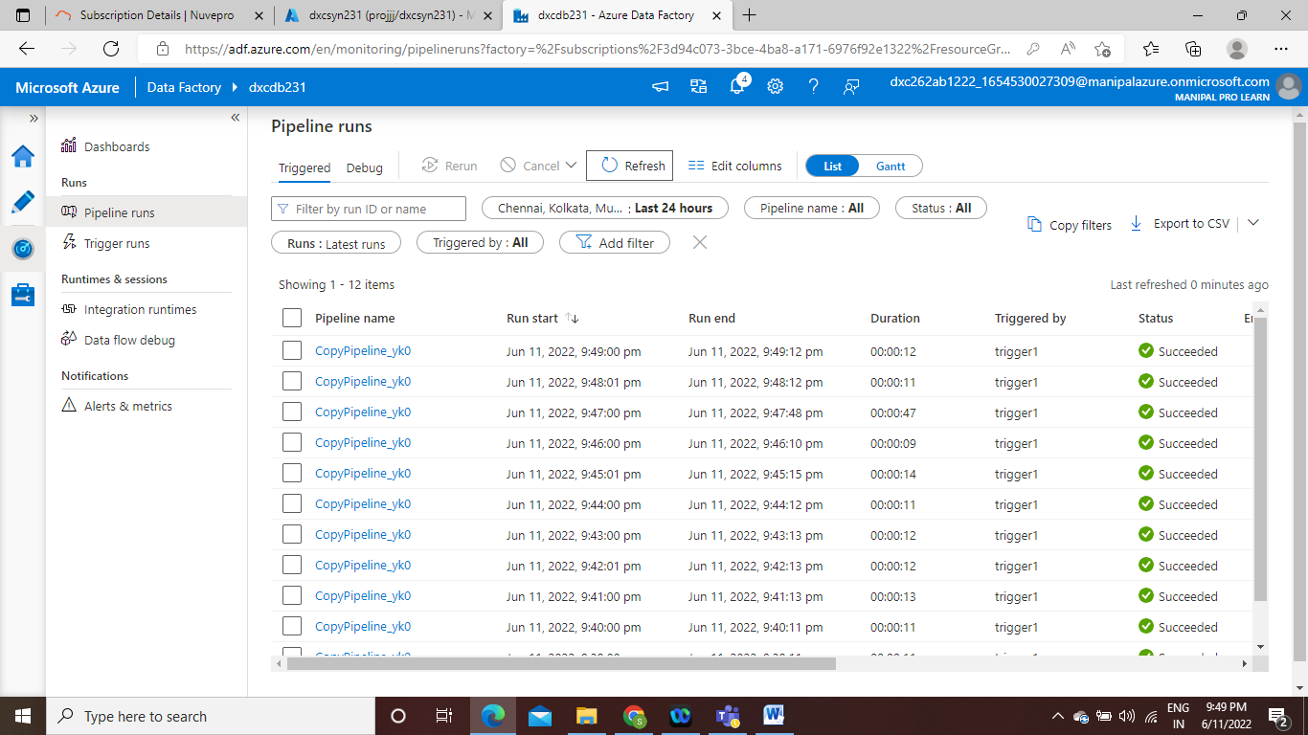
Creating trigger in datafactory

Slide 12
conclusion
Using Azure Data Factory, we were able to create a pipeline that will validate and copy the blob data into the SQL database in this project.
The Blob data has been validated and put in the SQL database.

Slide 13
Project-2
AP MORGAN DATA PLATFORM

Slide 14
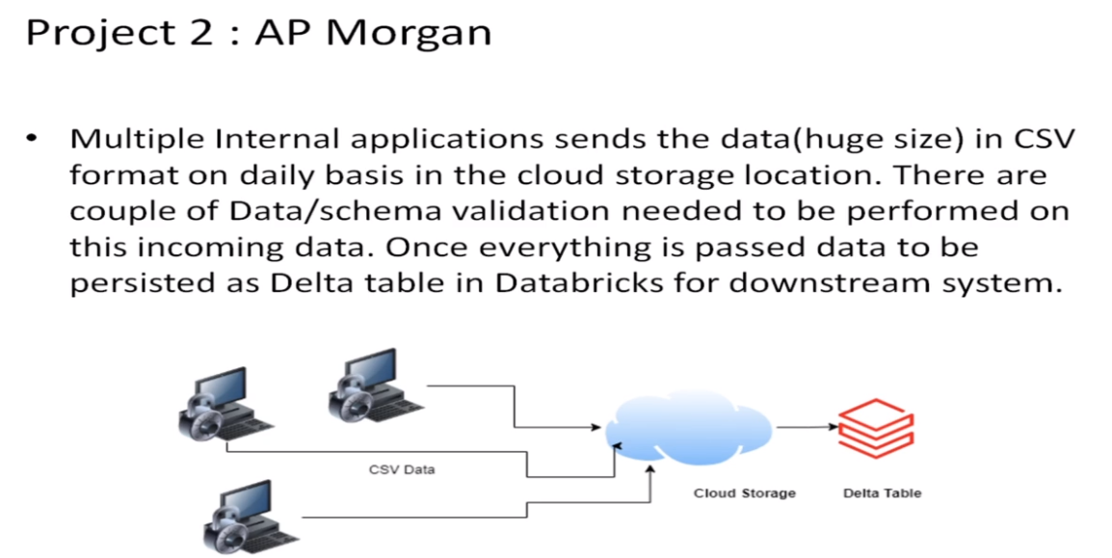
Problem statement:
Azure Databricks Linked Service in Azure Data Factory.

Slide 15
Things to do
Create data bricks
Creating the cluster in data bricks
Adding notebook in databricks and Implement BI
Creating data factory
Creating azure data bricks linked service in azure data factory

Slide 16
Services to build
To complete this project we need the resources
Azure Data Factory
Azure Data Bricks

Slide 17
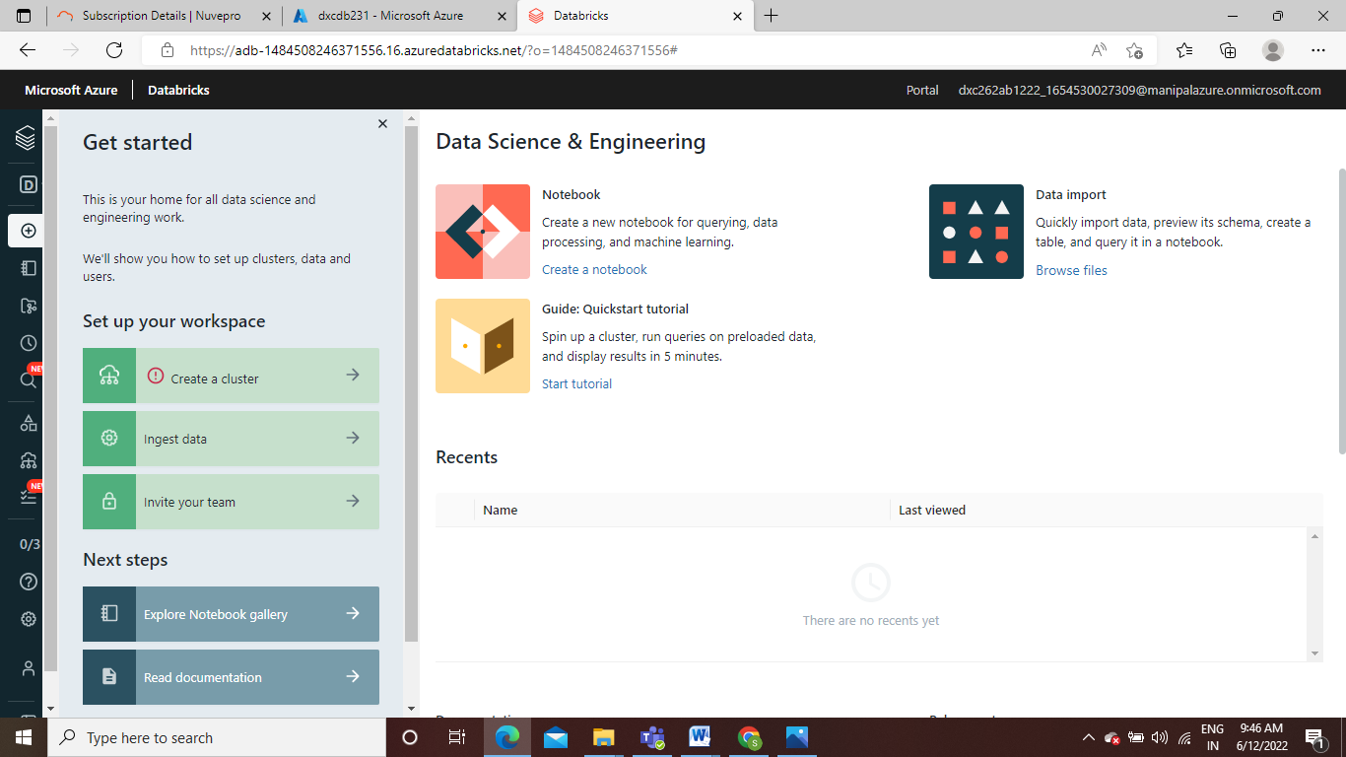
Create data bricks

Slide 18
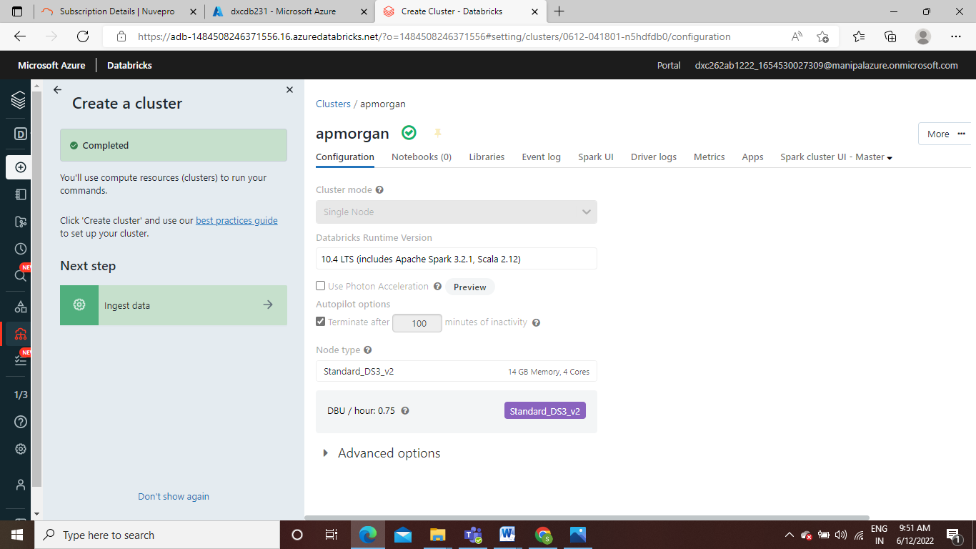
After creating db create cluster

Slide 19
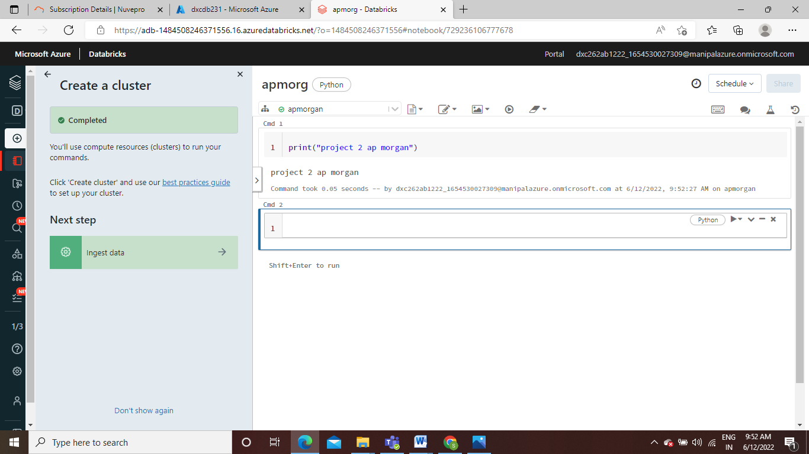
Create notebook

Slide 20
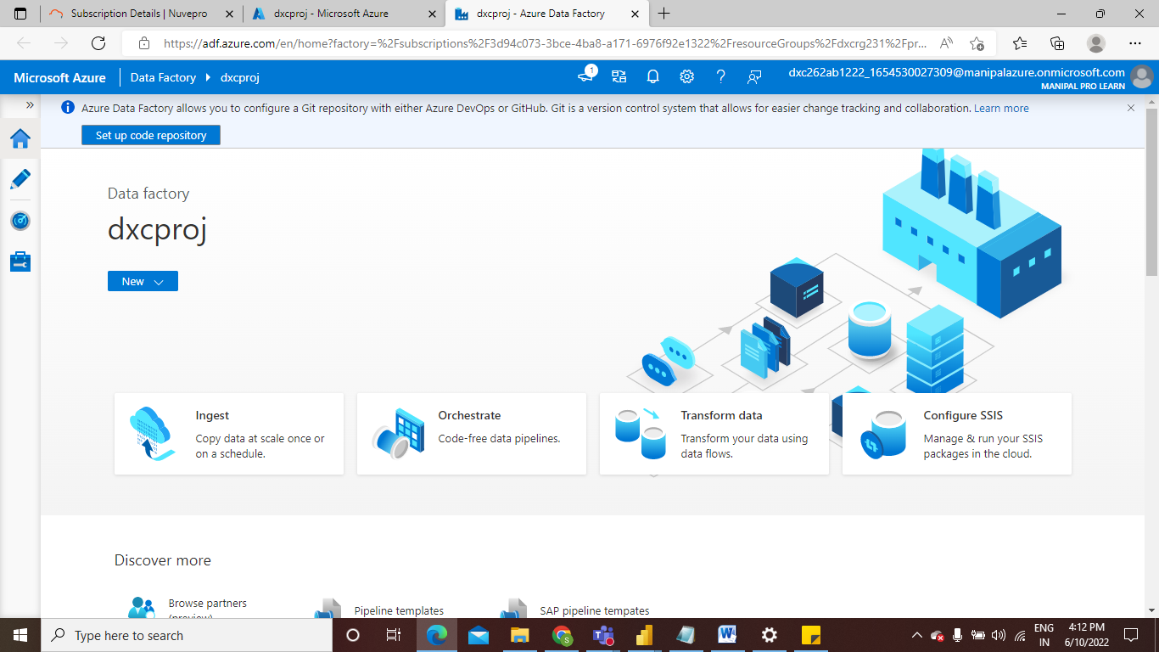
Create data factory

Slide 21
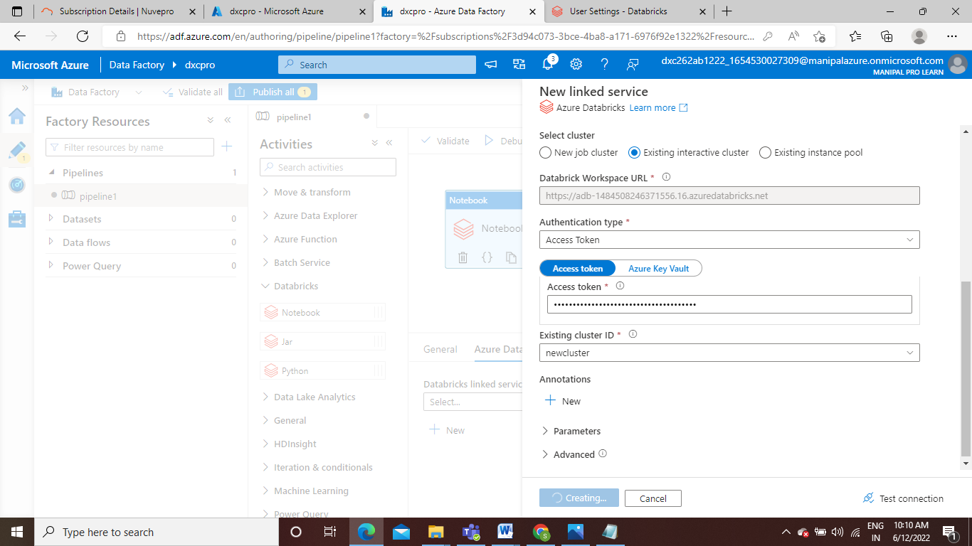
Azure Databricks Linked Service in ADF

Slide 22
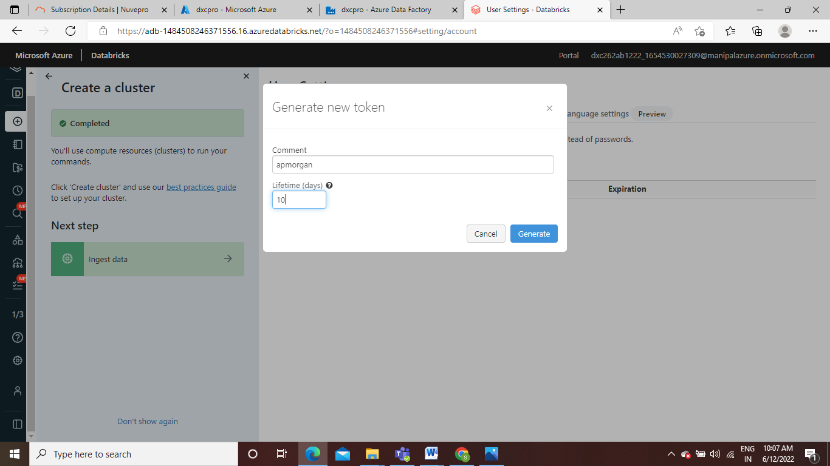
connection
To connect data factory and data bricks we create a token in data bricks access token in data factory

Slide 23
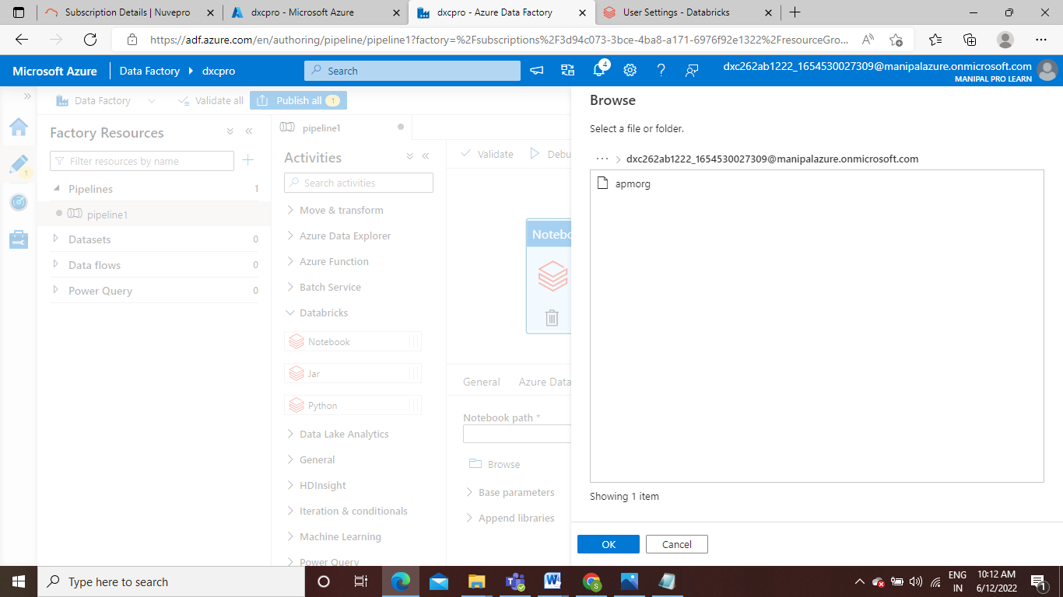
After connection
After connecting we can see note book we have generated in data bricks is visible in data factory

Slide 24
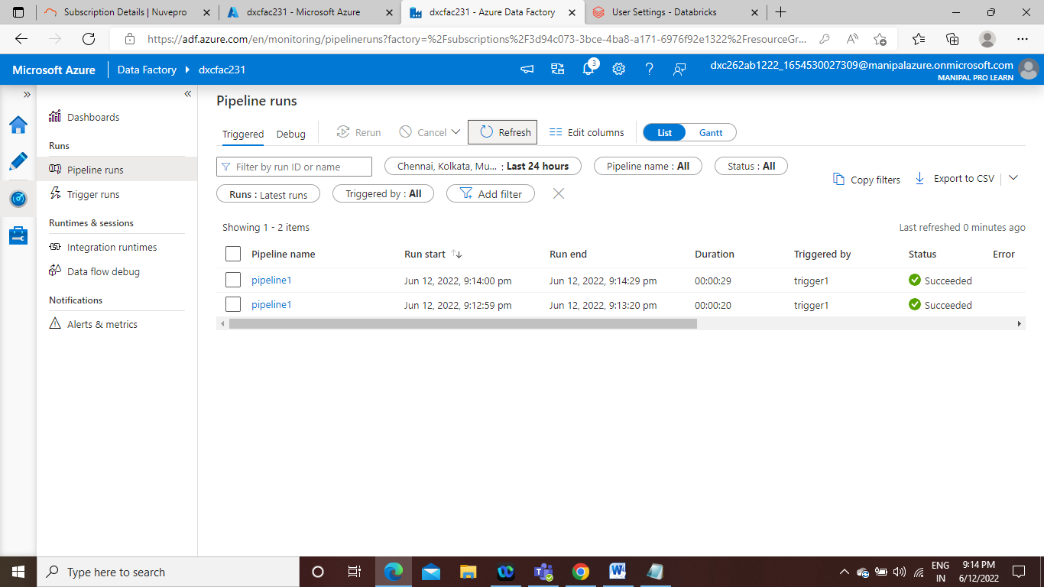
result

Slide 25
conclusion
Using Data Factory, I was able to successfully link and trigger an Azure DataBricks notebook.
Azure Data Factory and Azure Data Bricks are related.

